Slide 1
agentic AI Health Symptom Checker
INTERNSHIP PROJECT
Presented By :
Student name : Arpita Chaudhary
College Name : Ambalika Institute of Management and Technology
Department : CS-AIML

Slide 2
OUTLINE
Problem Statement
Technology used
Wow factor
End users
Result
Conclusion
Git-hub Link
Future scope
IBM Certifications

Slide 3
Problem Statement
Millions face confusion and misinformation when searching symptoms online, often leading to unsafe self-diagnosis and delayed care. There's a need for a reliable, multilingual, and intelligent assistant that understands natural symptom descriptions and guides users with safe, verified health information.
Proposed Solution: An AI-powered health checker that understands symptoms in natural language, offers safe advice using verified medical data, and guides users with urgency levels, home remedies, alerts and multilingual support — without making any diagnosis.

Slide 4
Technology used
IBM Cloud Lite Services
Natural Language Processing (NLP)
Trusted Medical Sources (Like WHO)
IBM Granite model

Slide 5
IBM cloud services used
IBM Cloud Watsonx AI Studio
IBM Cloud Watsonx AI runtime
IBM Cloud Agent Lab
IBM Granite foundation model
IBM Cloud Object Storage

Slide 6
Wow factors
This smart, multilingual AI health Symptom Checking Agent delivers safe, non-diagnostic symptom guidance in real time — personalized, accessible, and verified.
Unique features:
Natural language symptom interpretation.
Urgency triage (mild, moderate, severe).
Verified, non-diagnostic advice.
Multilingual interaction.
Real-time, safe, and user-friendly.
Prevents misinformation and reduces panic.
Promotes early action and awareness.

Slide 7
End users
General public (All age groups).
Rural and multilingual populations.
Healthcare helpdesks and NGOs.
Senior citizens and caregivers.
Health awareness campaigns.
Students & first-time symptom seekers.

Slide 8
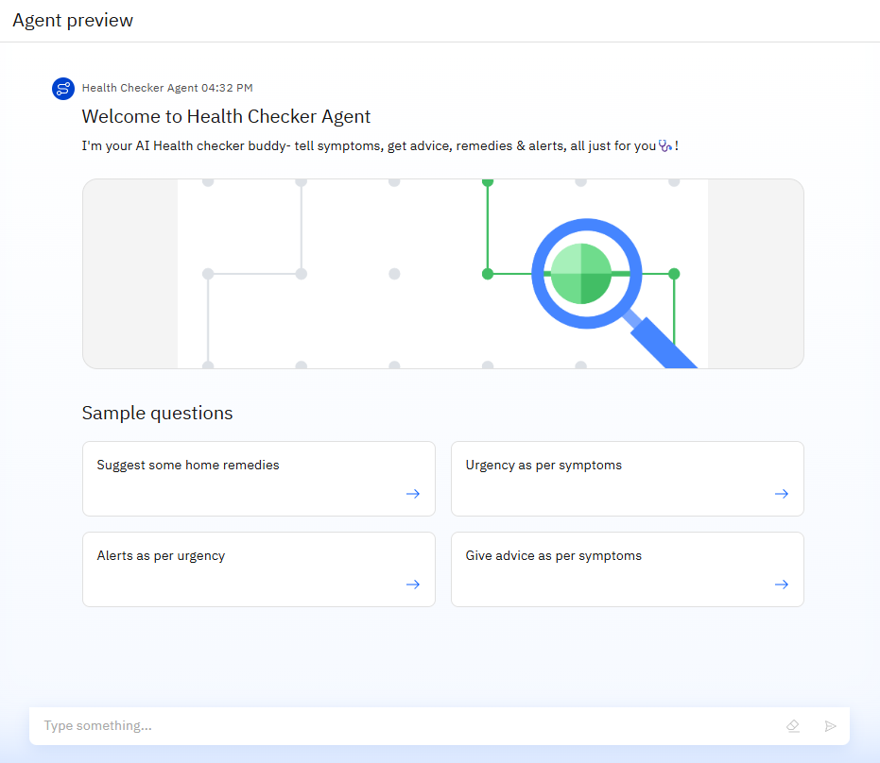
Results

Slide 9
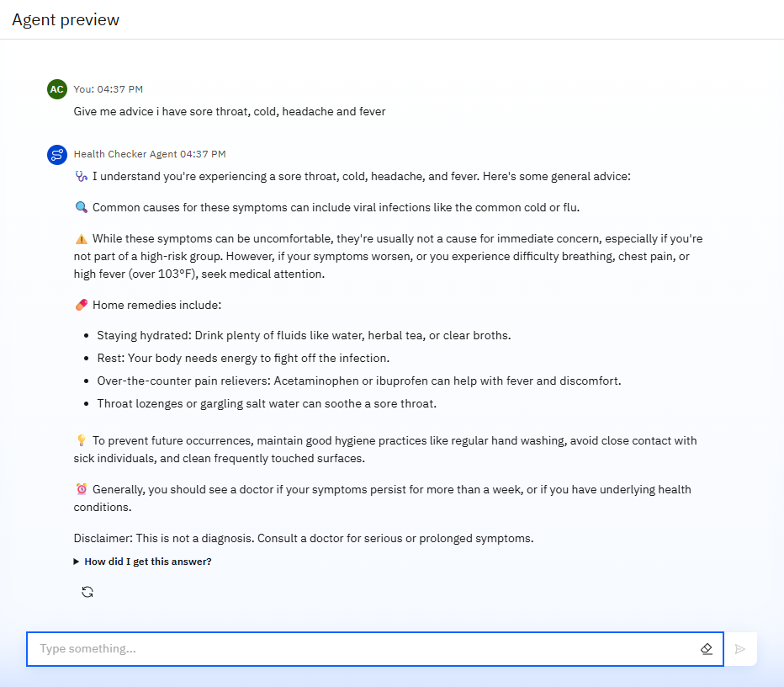
Results

Slide 10
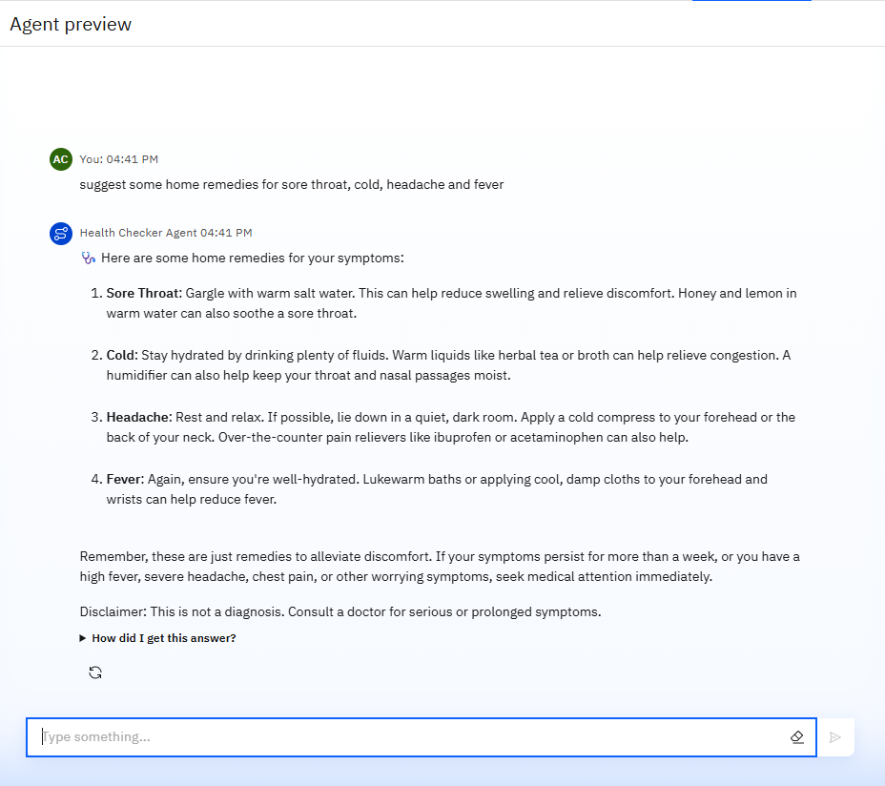
Results

Slide 11
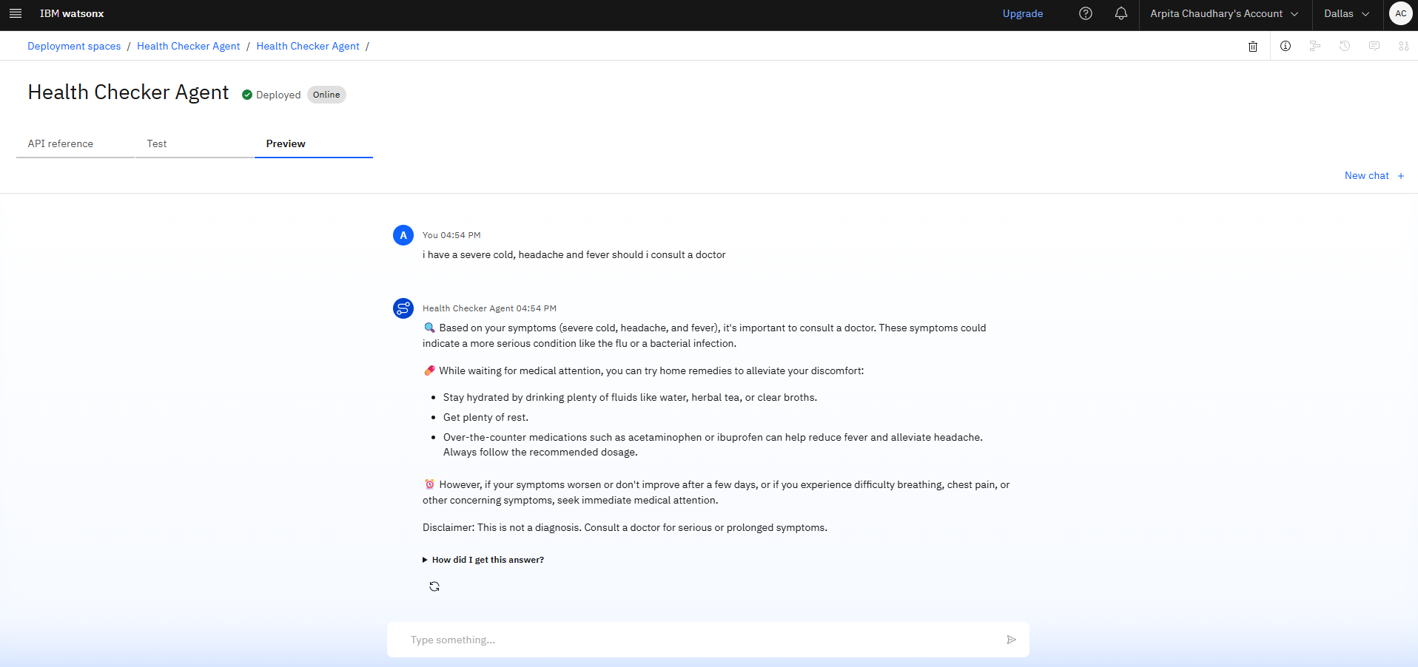
Results
Deployed AI Agent

Slide 12
Conclusion
The AI agent simplifies access to verified health information for all users, including non-tech-savvy individuals.
It provides symptom-based guidance without making diagnoses, ensuring safety and clarity.
By promoting early detection and awareness, it reduces panic and delays in care-seeking.
Multilingual support and a user-friendly design make it inclusive, empowering people to take informed health actions.

Slide 13
GitHub Link
Make sure that there should be readme file

Slide 14
Future scope
Voice interaction and accessibility integration.
Wearable health data integration (IOT).
Symptom tracking over time.
Geo-aware doctor and hospital recommendations.
Support for chronic condition monitoring.
Mental health check-ins.

Slide 15
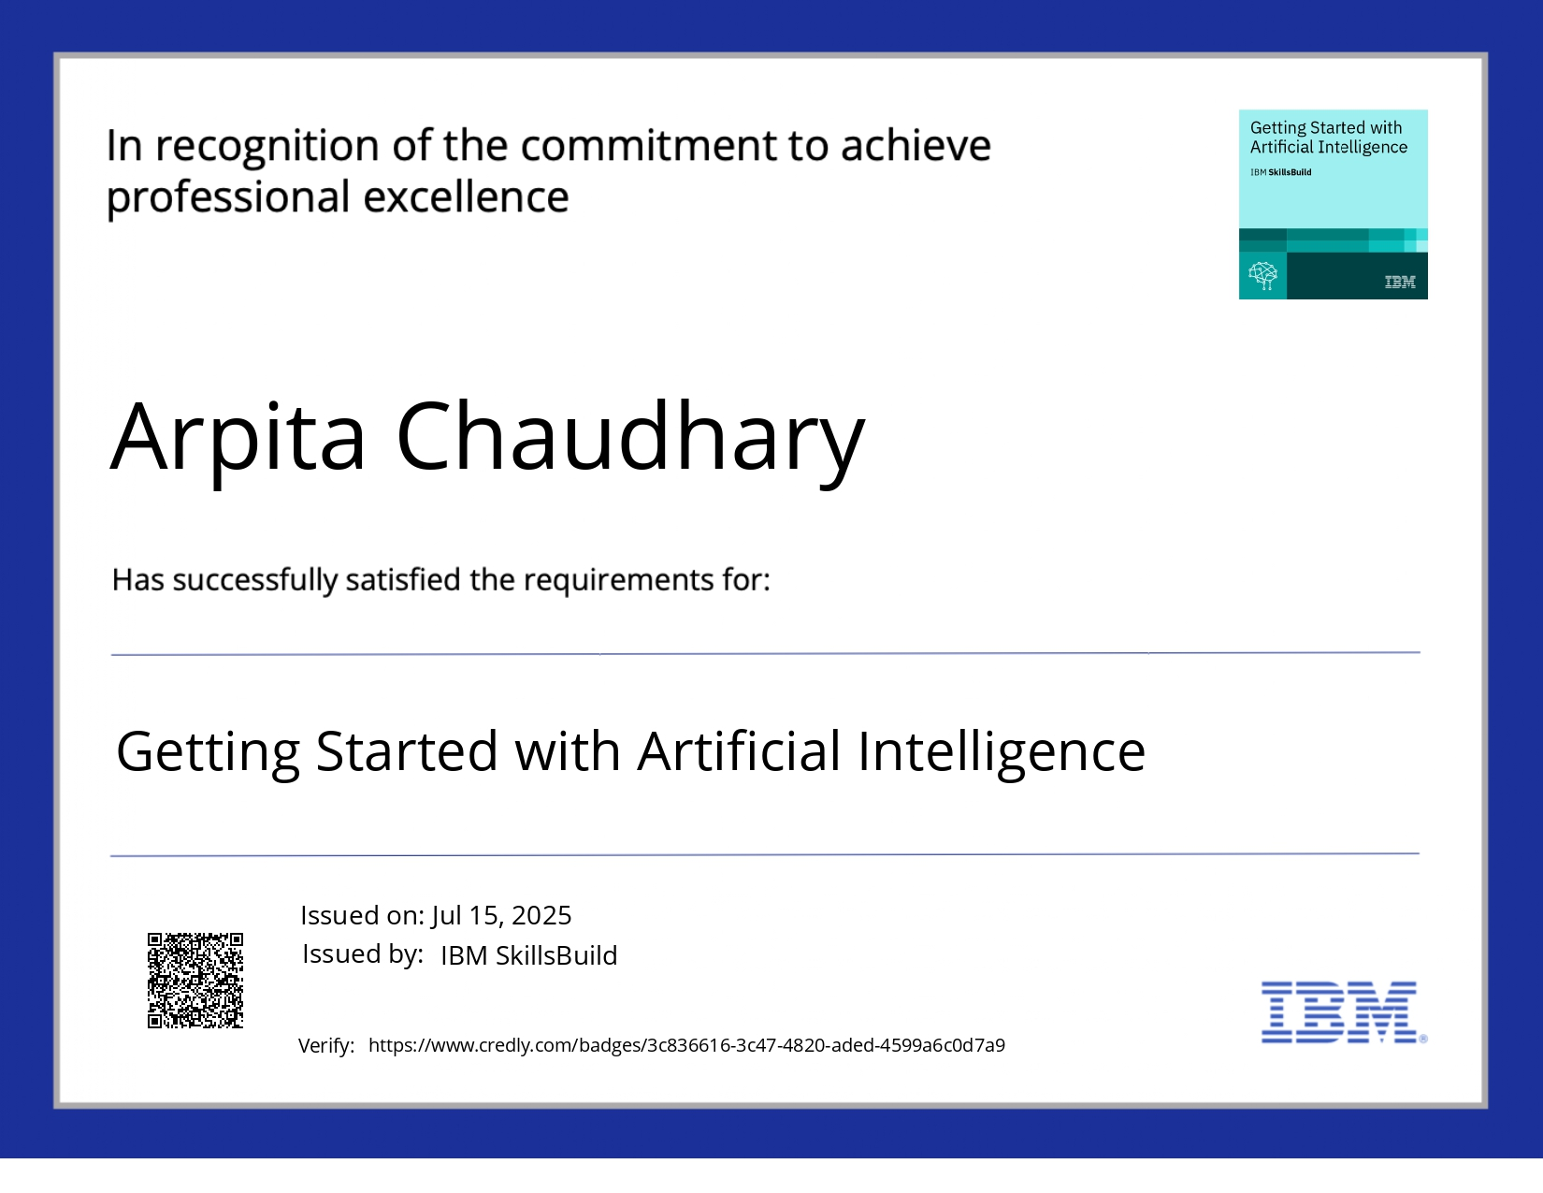
IBM Certifications

Slide 16


Slide 17
THANK YOU

